Slide 1
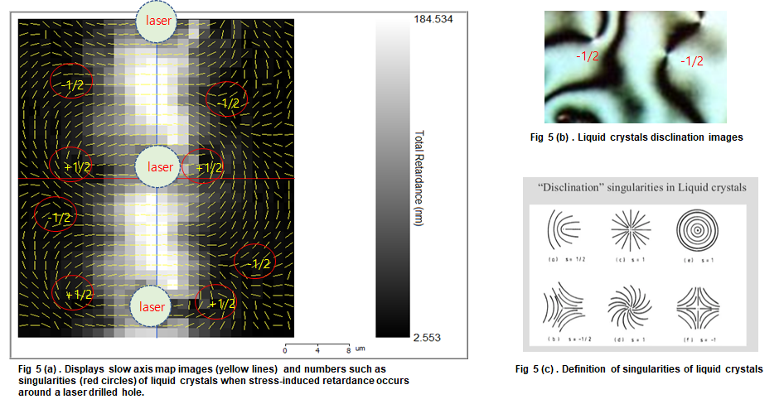
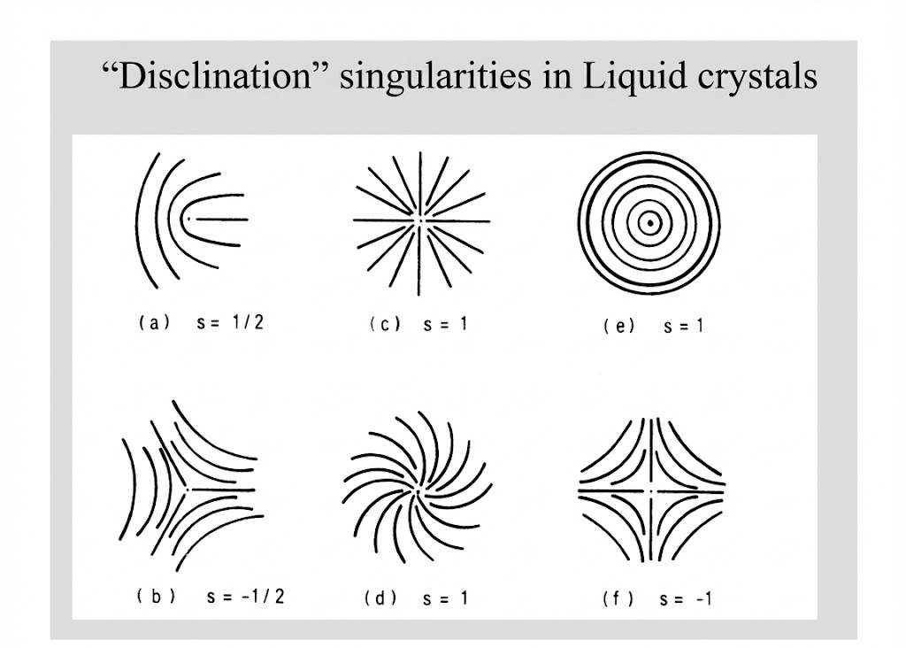

Slide 2
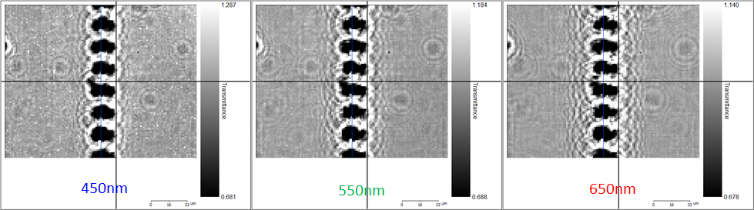

Slide 3
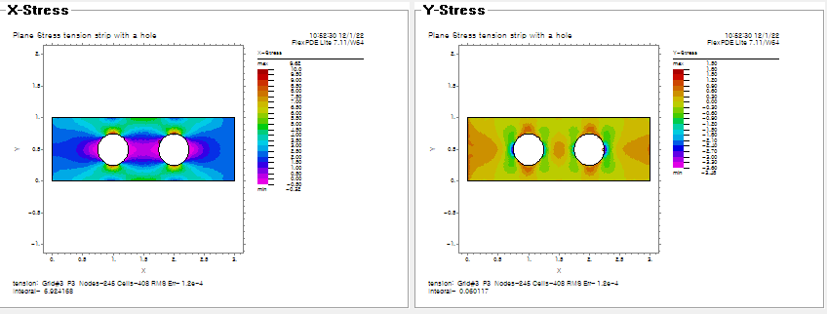

Slide 4
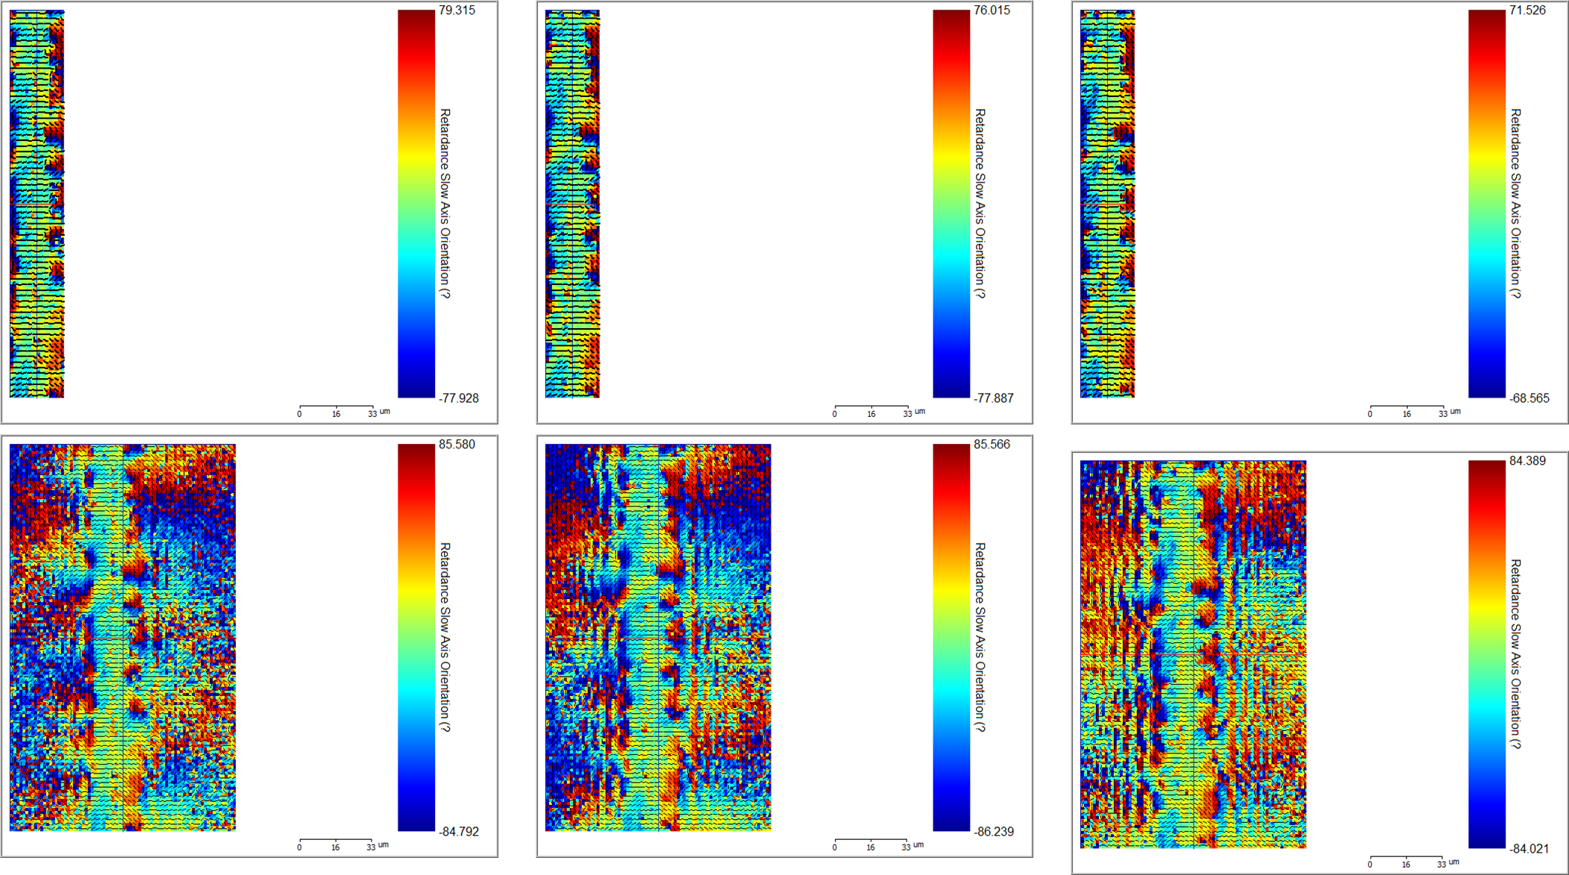

Slide 5
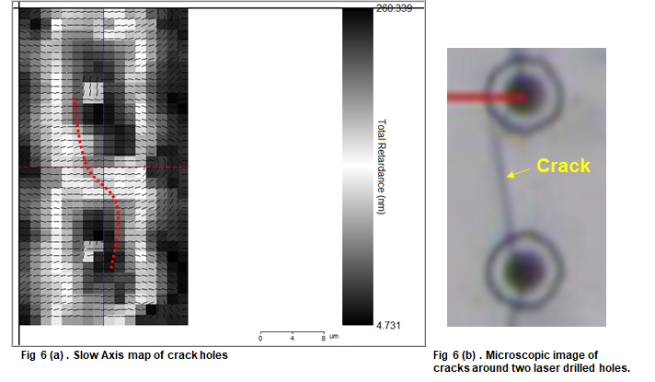
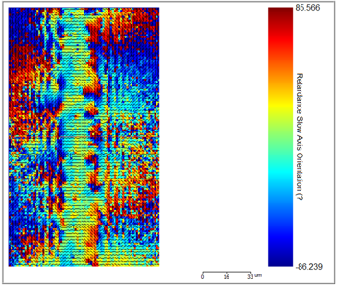
Fig 6 (a) Slow Axis Map near Laser Drilled Holes
Fig 6 (b) Microscopic Image of Crack
Fig 7 Retardation Slow Axis Orientation near Laser Drilled Holes

Slide 6
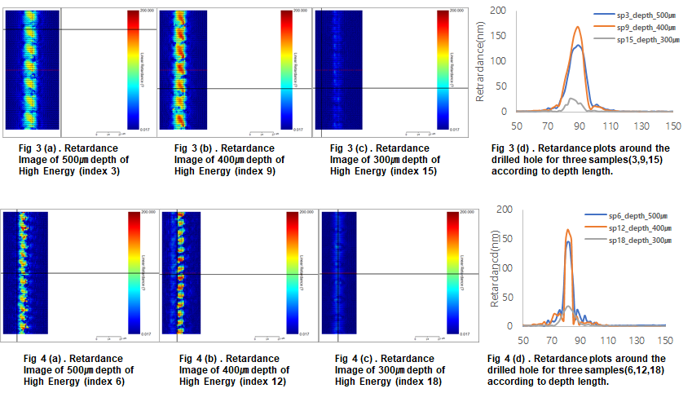
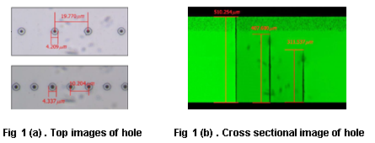
Table 1. Experimental Condition of Laser Drilled Holes
Index | Pulse Energy Level | Pitch (μm) | Target Depth (μm) | Note
1 | 1 (Low) | 20 | 500 | Through-hole
2 | 2 (Mid) | 20 | 500 | Through-hole
3 | 3 (High) | 20 | 500 | Through-hole
4 | 1 (Low) | 10 | 500 | Through-hole
5 | 2 (Mid) | 10 | 500 | Through-hole
6 | 3 (High) | 10 | 500 | Through-hole
7 | 1 (Low) | 20 | 400 | Half-cut (80%)
8 | 2 (Mid) | 20 | 400 | Half-cut (80%)
9 | 3 (High) | 20 | 400 | Half-cut (80%)
10 | 1 (Low) | 10 | 400 | Half-cut (80%)
11 | 2 (Mid) | 10 | 400 | Half-cut (80%)
12 | 3 (High) | 10 | 400 | Half-cut (80%)
13 | 1 (Low) | 20 | 300 | Half-cut (60%)
14 | 2 (Mid) | 20 | 300 | Half-cut (60%)
15 | 3 (High) | 20 | 300 | Half-cut (60%)
16 | 1 (Low) | 10 | 300 | Half-cut (60%)
17 | 2 (Mid) | 10 | 300 | Half-cut (60%)
18 | 3 (High) | 10 | 300 | Half-cut (60%)

